Slide 1
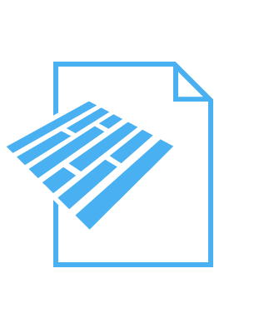



Architecture
Parquet files
S3
Lambda
Snowflake
Parquet files are loaded into s3 monthly
S3 triggers lambda function
Lambda connects to snowflake and runs copy command to ingest data

Slide 2



Architecture
dbt
dbt
Raw
Curated
Consumption
Tableau
dbt transforms and cleans the semi-structured data and loads into curated layer
dbt transforms and loads data in consumption layer as per Dimensional Data Model
Parquet data loaded in raw layer as variant data type
Cleaned structured data is stored in this layer
Data loaded in dimensions and fact table
Dashboard to visualize the data

